Slide 1
IPN Summer School | 2021-06-30
Graph Theory
Vincent Bazinet
McGill University
Montreal Neurological Institute
Notes:
The lecture is focused on graph theory.
A field of mathematics with primary goal: the study of graphs a.k.a networks.

Slide 2
Outline
Hour 1: Theory
What is graph theory?
How do we reconstruct a brain network?
What are the common measures used in graph theory?
What has graph theory told us about the brain?
What are the exciting new avenues in network neuroscience?
Hour 2: Practice

Slide 3
Outline
Hour 1: Theory
What is graph theory?
How do we reconstruct a brain network?
What are the common measures used in graph theory?
What has graph theory told us about the brain?
What are the exciting new avenues in network neuroscience?
Hour 2: Practice

Slide 4
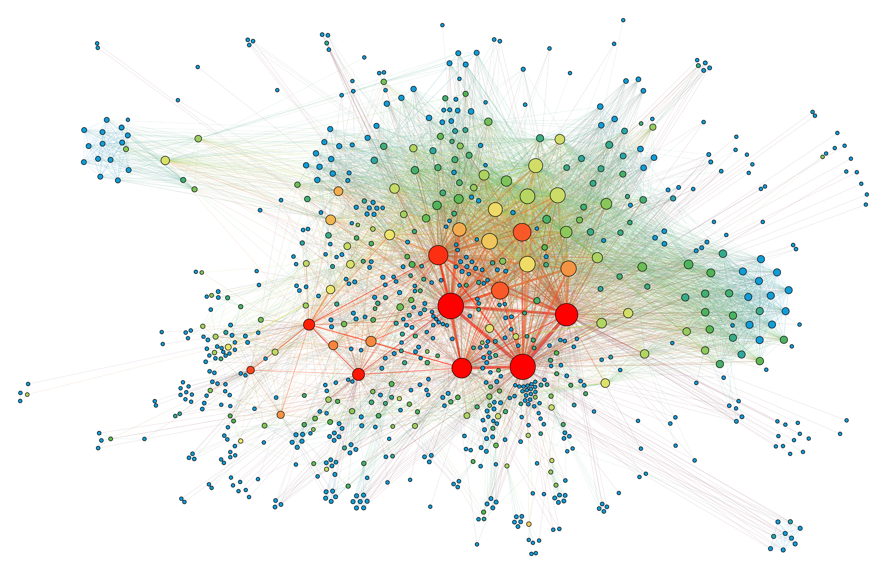
nodes
edges
Notes:
What is a network?
Networks: mathematical objects that describe relationships among elements.
Node : unit or element
Edge or connection: relationship among elements.
Physical: each node is a house, each edge is the transmission line
Non-physical: each node is a person, each edge is the relationship between them
Goal is study how multiple elements interact with each other.
Examples of complex systems:
Social networks (Facebook)
Technological networks (the Internet)

Slide 5
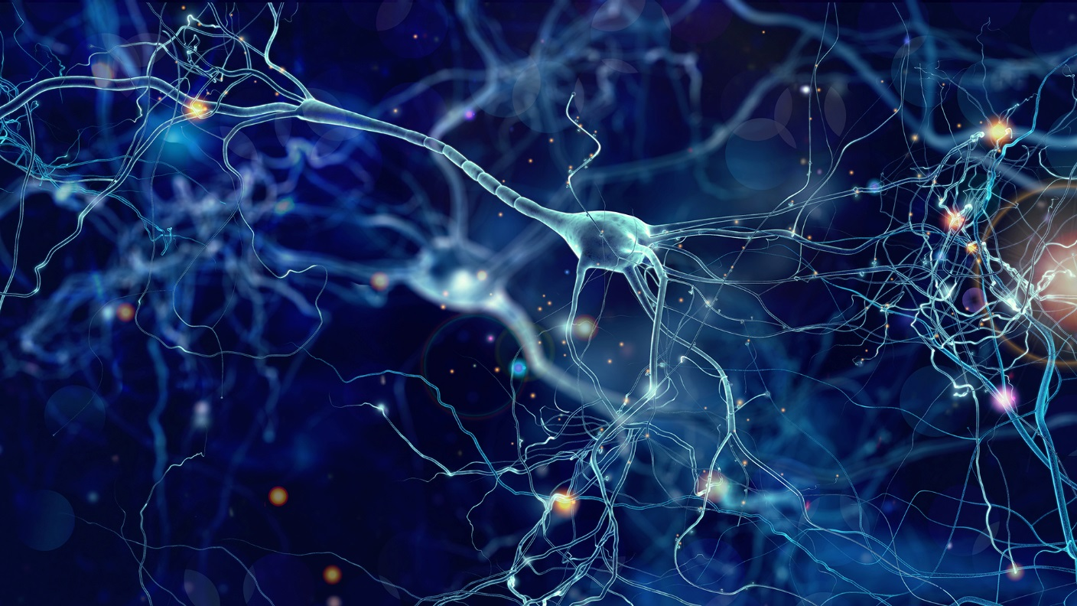
Notes:
The brain is a network: since Ramon Y Cajal’s neuron doctrine (Early 1900s)
Brain consists of extremely large number of inter-connected neurons

Slide 6
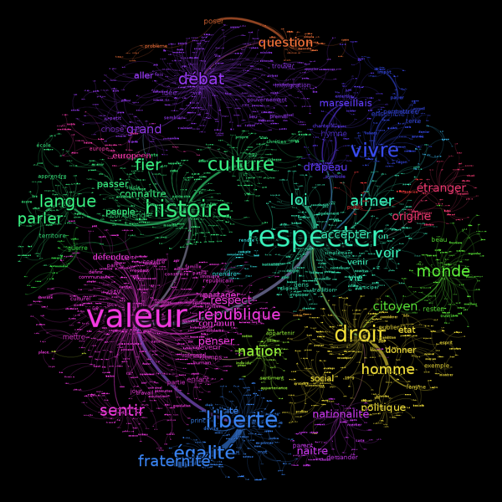
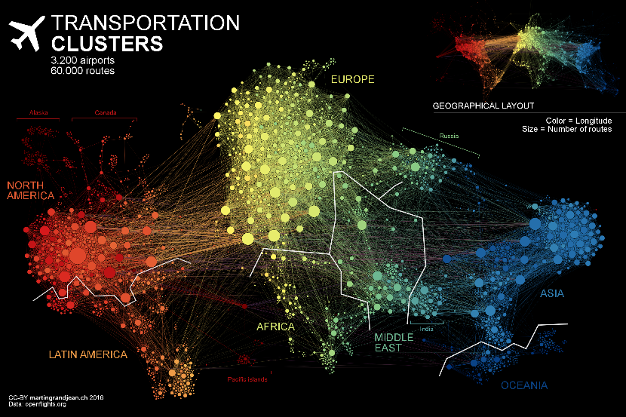
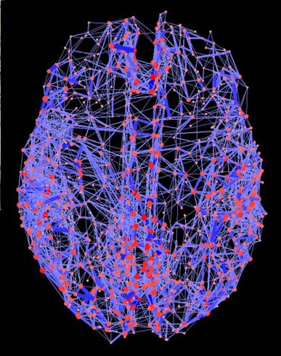
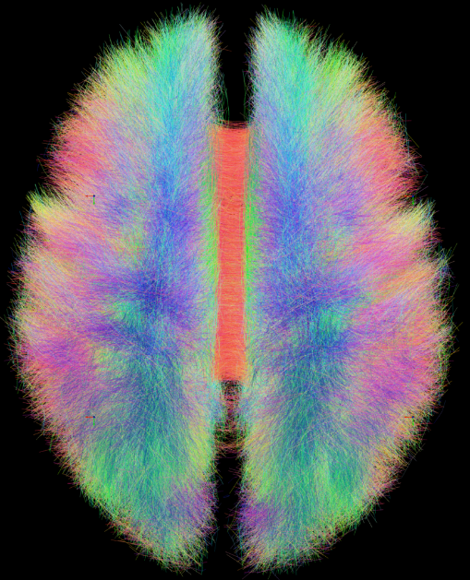
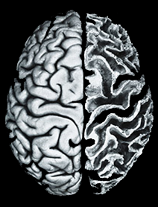
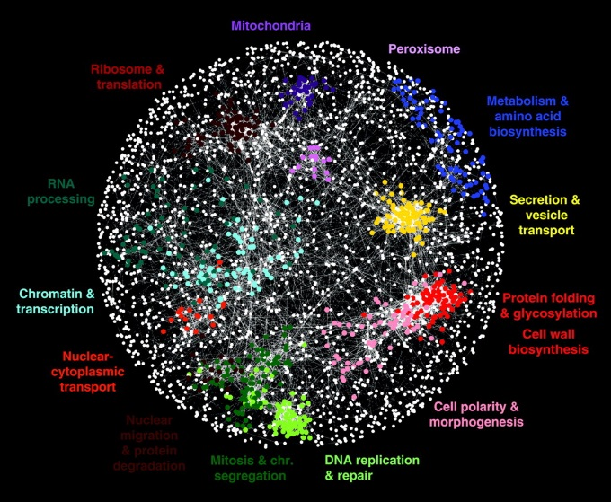
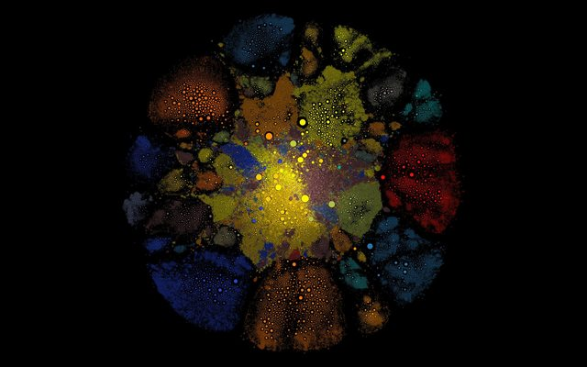
semantic landscapes
airline routes
connectome
connectomes
genetic interactions
gamer alliances
Notes:
Main idea: take the brain, map out the connections, create an abstract representation of these connections
We can take diffusion MRI to reconstruct “white matter fiber tracts”
This network is often called the connectome.
As mentioned, a variety of other networks exist.

Slide 7
Outline
Hour 1: Theory
What is graph theory?
How do we reconstruct a brain network?
What are the common measures used in graph theory?
What has graph theory told us about the brain?
What are the exciting new avenues in network neuroscience?
Hour 2: Practice

Slide 8
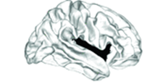
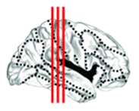
Reconstructing brain networks
1. Parcellating the brain into nodes
Sporns (2013) Dialogues Clin Neurosci
Notes:
The first step that we have to do, is to parcellate the brain into nodes (brain regions).

Slide 9
Defining nodes
Notes:
What is a “good” parcellation?
spatially constrained/contiguous
internal homogeneity
external differentiation
Depends on scientific question and imaging modality
Best practice: try multiple parcellations + resolutions

Slide 10
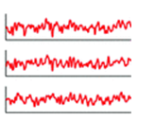
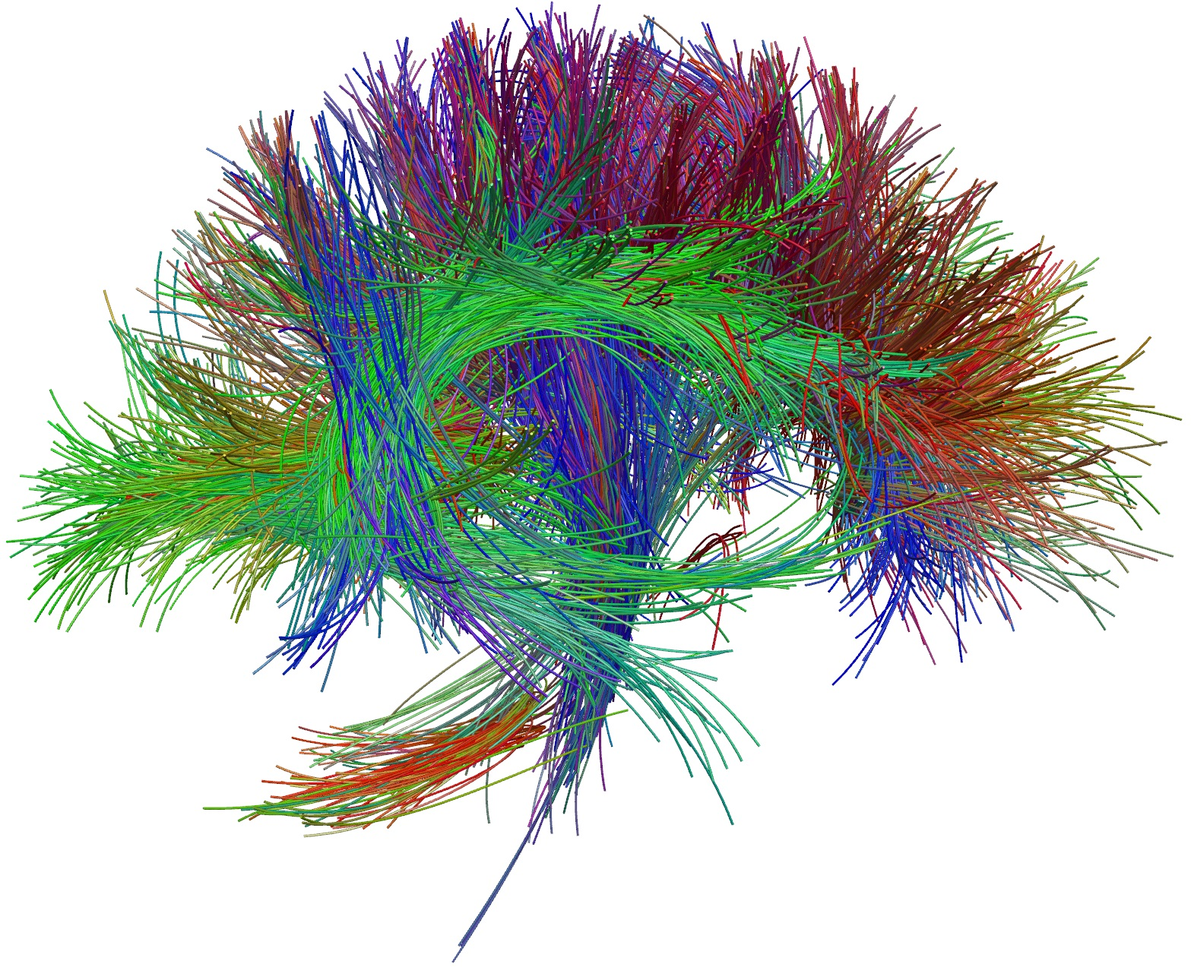
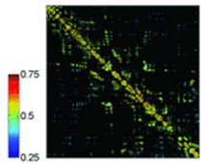
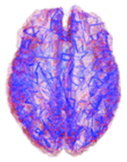
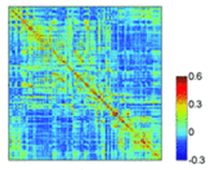
Reconstructing brain networks
structural connectivity (SC)
functional connectivity (FC)
physical infrastructure
stable
sparse
statistical associations
dynamic
multiple configurations
2. diffusion (structural) data
2. time series (functional) data
1. parcellating the brain into nodes
3. structural brain network
4. network analysis
3. functional brain network
Sporns (2013) Dialogues Clin Neurosci
Notes:
Once we have parcellated our brain, we must decide what type of network we want to reconstruct: structural or functional

Slide 11
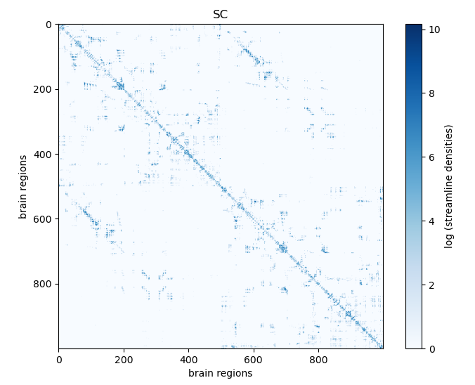
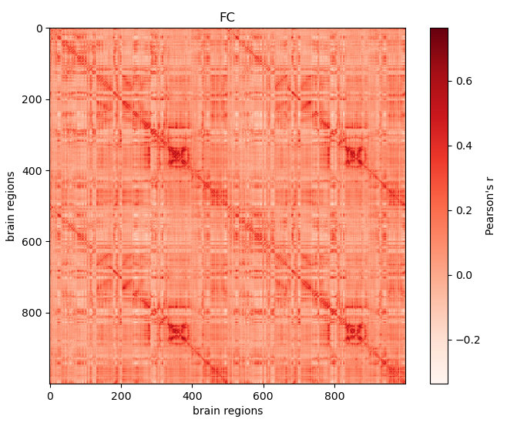
Reconstructing brain networks
structural connectivity
functional connectivity
Sporns (2013) Dialogues Clin Neurosci
Notes:
Our network will most of the times be represented in an adjacency matrix that look like those.

Slide 12
Outline
Hour 1: Theory
What is graph theory?
How do we reconstruct a brain network?
What are the common measures used in graph theory?
What has graph theory told us about the brain?
What are the exciting new avenues in network neuroscience?
Hour 2: Practice

Slide 13
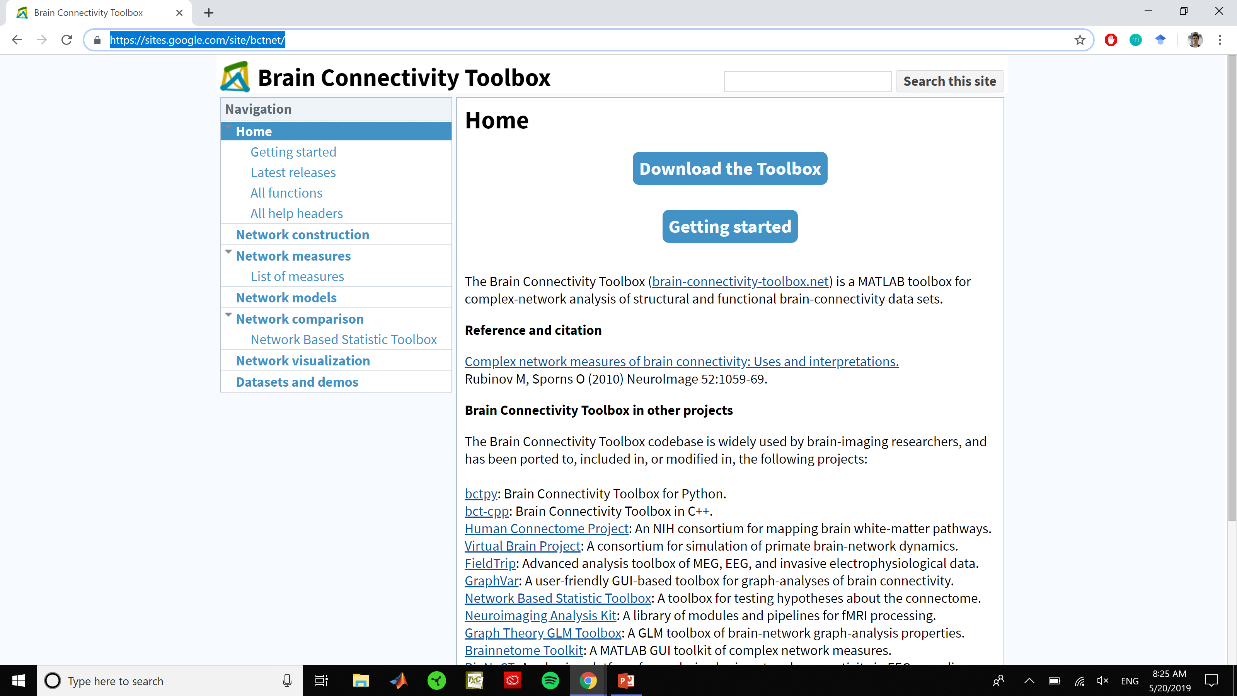
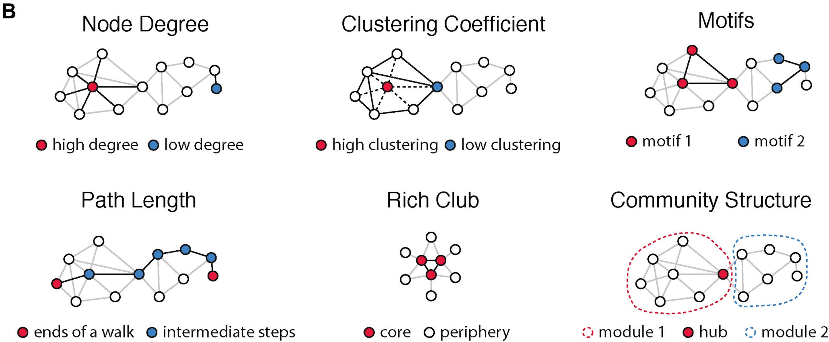
Network measures
segregation
clustering
motifs
modularity
integration
path length
efficiency
influence
degree
betweenness
participation
Rubinov & Sporns (2010) NeuroImage | http://www.brain-connectivity-toolbox.net/

Slide 14
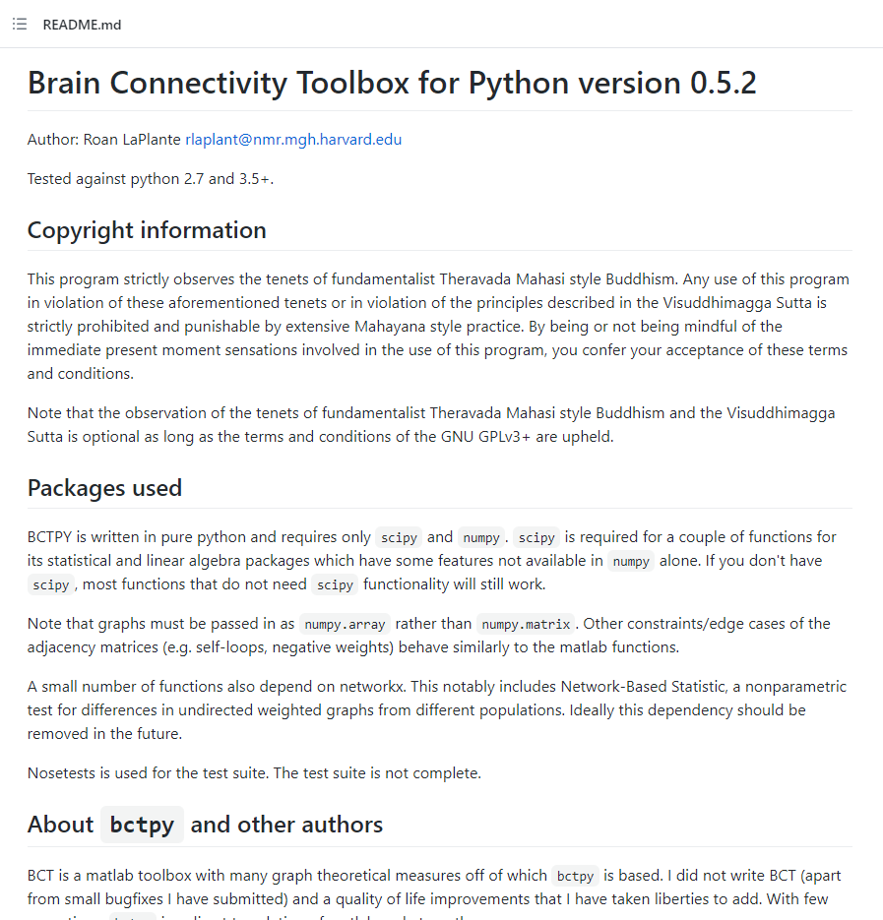

Slide 15
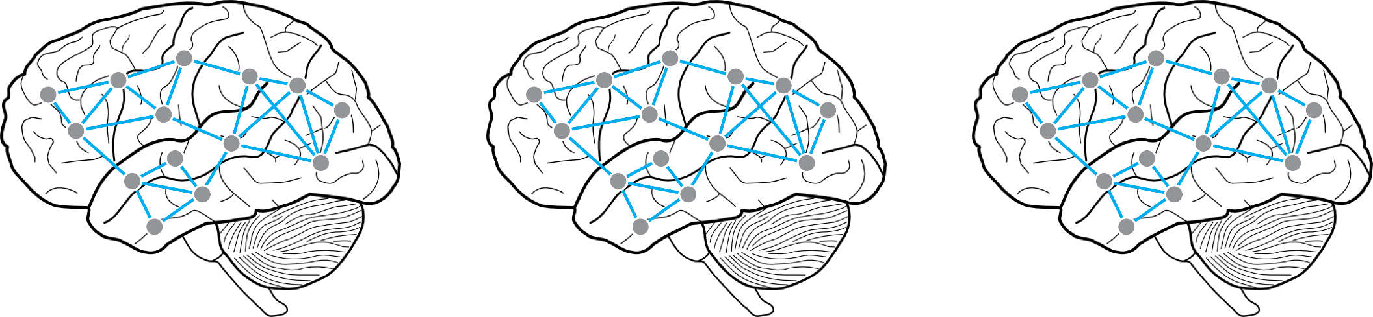
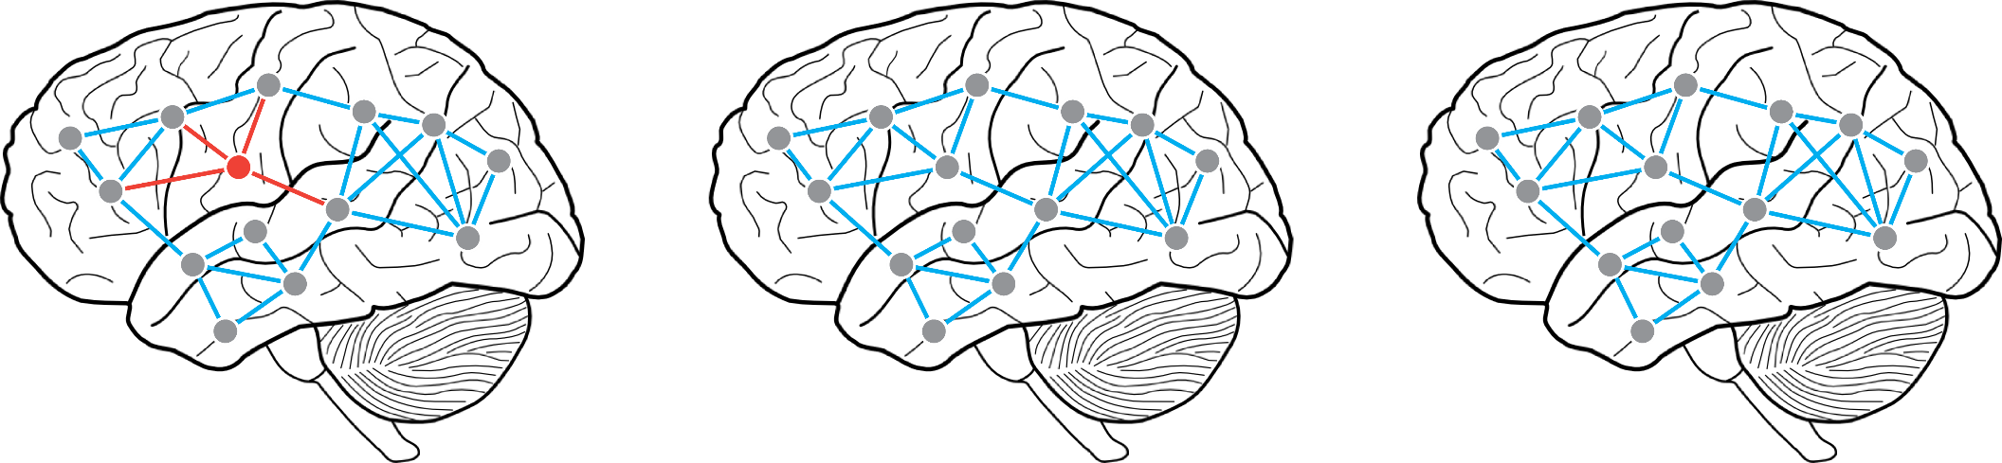
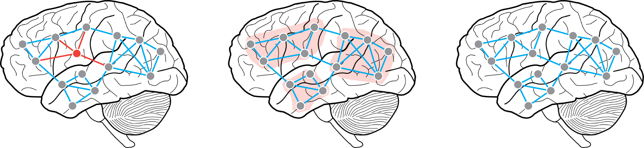
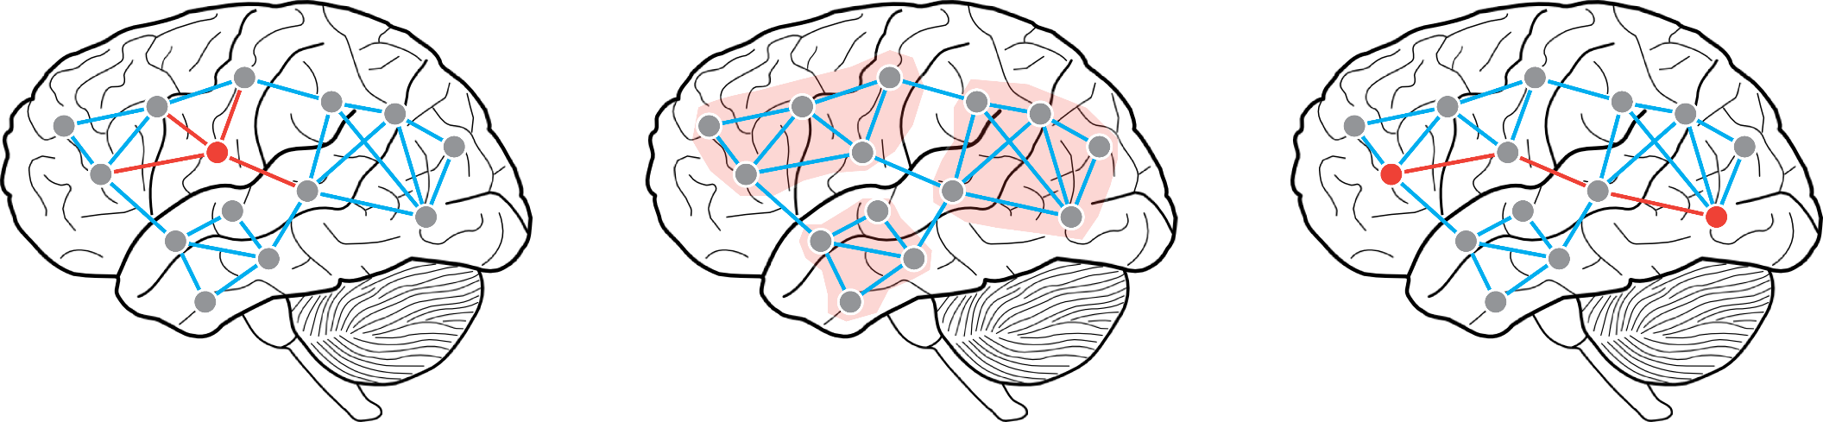
Network measures
local: the influence of a node or an edge
meso: associations among groups of nodes
global: configuration of the whole network
advantages: network structure summarized by scalar
disadvantages: not localized, simplifies complex patterns

Slide 16
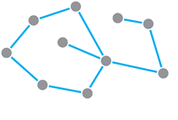
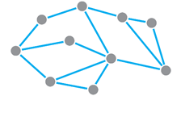
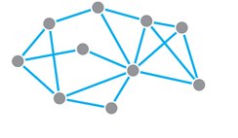


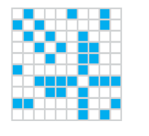
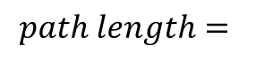

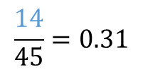
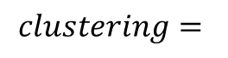
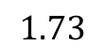
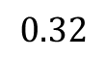
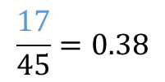
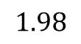
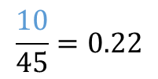
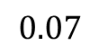
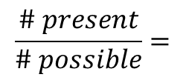
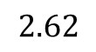
Global measures
density: proportion of possible connections that are actually observed
a fundamental property – every other property scales with density
choosing the density:
keep as-is
match to some “ground truth”
set + vary statistically
match groups/conditions
$$\frac{\# present}{\# possible}=$$
$$\frac{10}{45}=0.22$$
$$\frac{14}{45}=0.31$$
$$\frac{17}{45}=0.38$$
$$path length=$$
$$2.62$$
$$1.98$$
$$1.73$$
$$clustering=$$
$$0$$
$$0.07$$
$$0.32$$

Slide 17
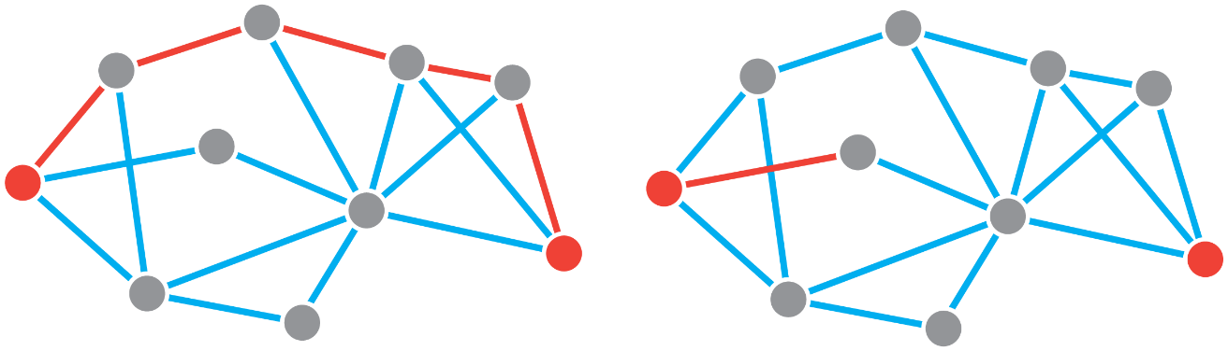
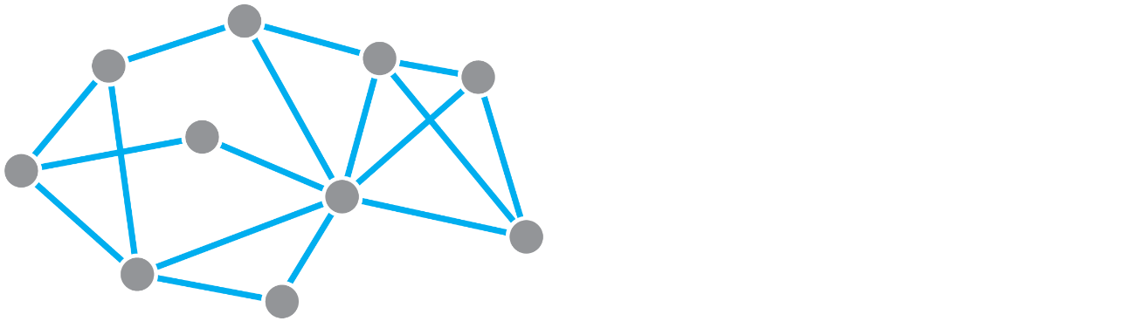

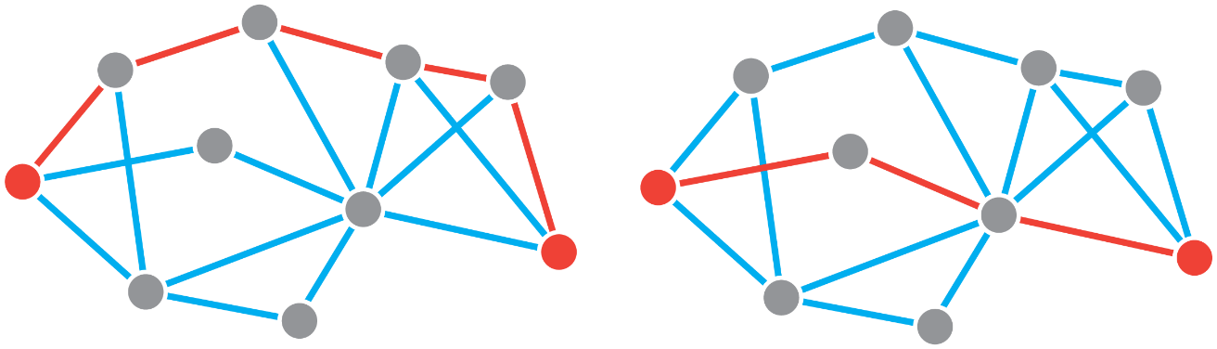
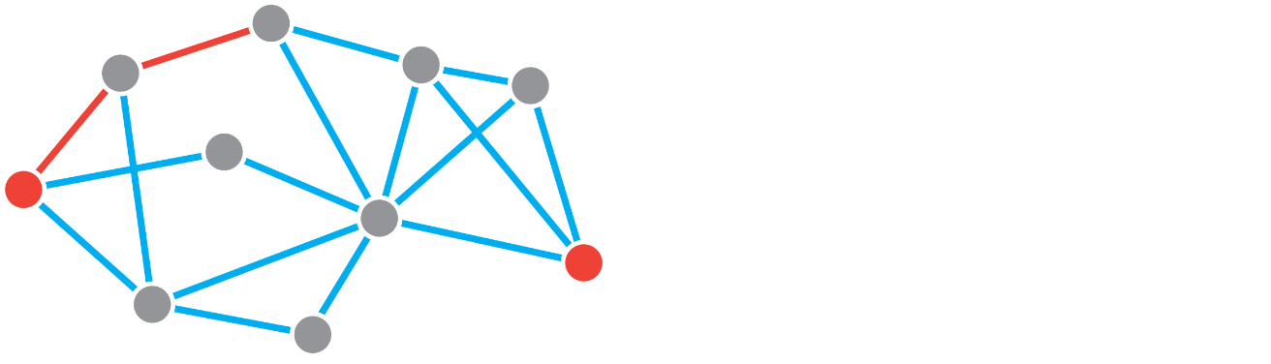
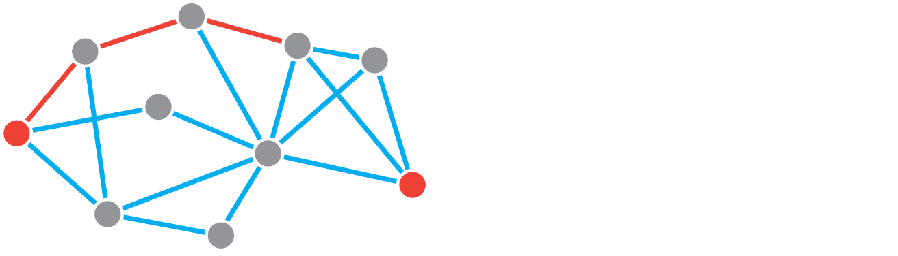

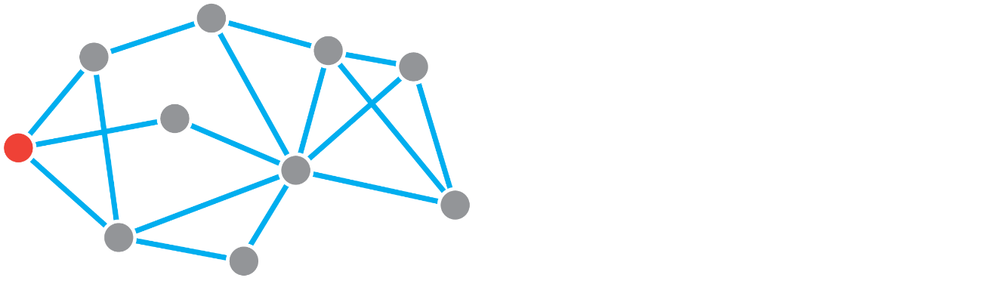

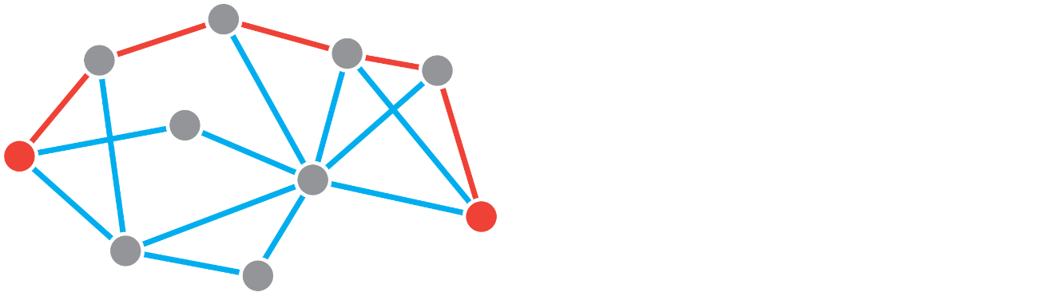
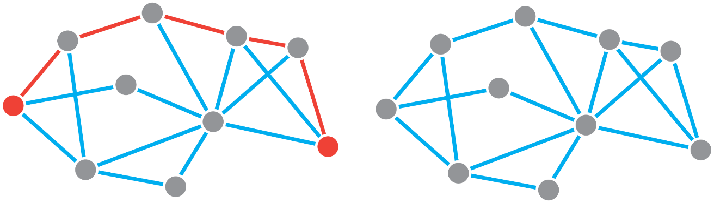
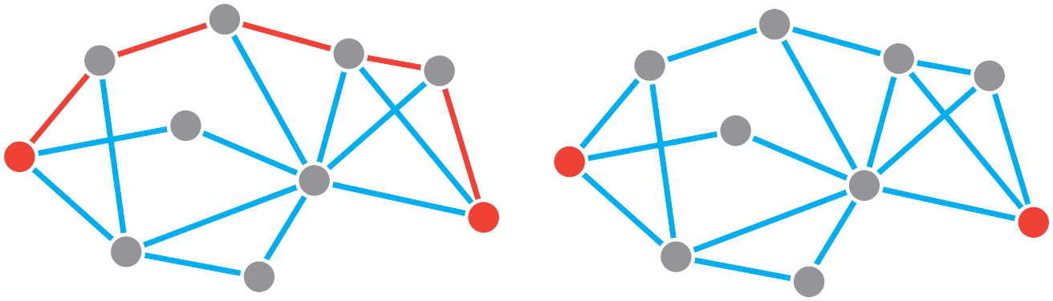
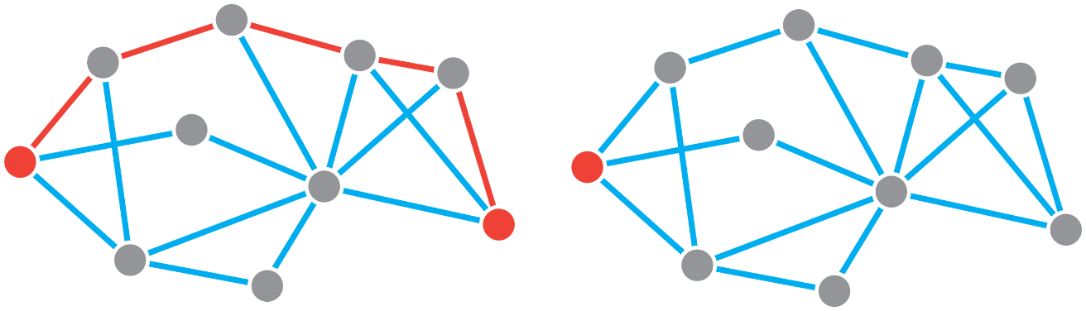

Global measures
walk: non-repeating sequence of edges between two nodes
path: shortest contiguous set of edges between all pairs of nodes
characteristic path length: mean path length among all pairs of nodes
walk length (i,j) = 5
path length (i,j) = 3
global efficiency: average reciprocal path length
low path length / high efficiency implies greater communication capacity, lower signal attenuation
centralized communication protocols assume knowledge of global topology
alternative measures of decentralized communication, e.g. random walks, navigation, etc.
Notes:
Before introducing next measure: walk and paths.
Paths are used to compute the network’s characteristic path length and global efficiency.
Measures of communication capacity.
Characteristic path length assumes centralized communication protocol

Slide 18

Global measures
Local clustering coefficient : ratio between the number of edges between a node’s neighbors and the maximum number of edges that could exist between them.
Global clustering coefficient : mean of the local clustering coefficient.
transitivity : ratio between number of “closed triplets” and number of all “triplets” in a network.

Slide 19

Global measures
Small-world regime: highly clustered (like social networks), but you can easily find a path between any two nodes with a short number of hops
Many real-world networks have this combination (high clustering, low path length), including C.elegans nervous system
Watts & Strogatz (1999) Nature

Slide 20
Local measures
local: the influence of a node or an edge
meso: associations among groups of nodes
global: configuration of the whole network
advantages: identify influential elements
disadvantages: often correlated; assume specific mechanisms

Slide 21
Local measures
centrality: which node in our network is the most important?
degree centrality: how many direct connections does a node have?
betweenness centrality: how many shortest paths passes through a node?
closeness centrality: how close is a node to the rest of the nodes in the network?
vulnerability: change in capacity (e.g. efficiency) following lesion
most measures are correlated and with each other
most measures imply a specific signaling/transport mechanism
BCT: degrees_und.m | degrees_dir.m | strengths_und.m | strengths_dir.m | betweenness_bin.m | betweenness_wei.m
Oldham et al. (2019) PLoS ONE

Slide 22
Meso-scale measures
local: the influence of a node or an edge
meso: associations among groups of nodes
global: configuration of the whole network
advantages: identify sub-systems, patterns of association
disadvantages: model-based, must be detected algorithmically

Slide 23








Meso-scale measures
difference
(B = A – P)
meso-scale structure is rarely visually apparent
observed (A)
expected (P)
communities: groups of nodes whose observed density of connections is maximally greater than expected by chance
high-quality partitions concentrate the strongest elements of B within communities:
null model
high-quality
low-quality
Newman & Girvan (2004) Phys Rev E
Slide credit: Rick Betzel, IU
Fortunato (2010) Phys Rep

Slide 24



Community detection
modules or communities must be detected algorithmically
modularity function: the quality of a given partition $c$
Kronecker delta function is 1 when $c_{i}=c_{j}$, and 0 otherwise
user must specify criteria (i.e. what is a community?)
in brain imaging, a community is usually assumed to be modular
user must specify detection algorithm
$$Q= \sum_{ij}{[A_{ij}−P_{ij}]δ(}c_{i},c_{j})$$
community assignment of node i
observed connection weight between nodes i and j
expected connection weight between nodes i and j
keep a running sum for all node pairs
if two nodes are in the same community, compute the difference between observed and expected, and add to sum
the final value of Q is a measure of how prominent or statistically unexpected the within-community connections are
modularity-maximization algorithms (e.g. the ‘Louvain’ algorithm) are particularly popular
user must specify parameters and validate
BCT: community_louvain.m
Newman & Girvan (2004) Phys Rev E
Fortunato (2010) Phys Rep

Slide 25





Multiscale modularity
$$Q= \sum_{ij}{[A_{ij}−P_{ij}]δ(}c_{i},c_{j})$$
$$Q(γ)= \sum_{ij}{[A_{ij}−{γP}_{ij}]δ(}c_{i},c_{j})$$
introduce a “resolution” parameter ($γ$) that weighs the importance of the null model
low values make it more likely to identify large communities
high values make it more likely to identify small communities
Fortunato & Barthelemy (2007) Proc Natl Acad Sci USA
Sporns & Betzel (2015) Annu Rev Psychol
Reichardt & Bornholdt (2010) Phys Rev E

Slide 26




System organization
connector
provincial
kinless
hubs
periphery
within-module degree: is a node more/less connected than other nodes in the same community?
participation: are a node’s links distributed across communities or concentrated within?
$$z_{i}= \frac{κ_{i}−{\overline{κ}}_{gi} }{σ_{g_{i}}}$$
$$P_{i}=1−\sum_{g=1}^{M}{{\left(\frac{κ_{ig}}{k_{i}}\right)}^{2}}$$
BCT: participation_coeff.m | participation_coeff_sign.m | module_degree_zscore.m
Guimera & Amaral (2004) Nature
Sporns & Betzel (2014) Annu Rev Neurosci

Slide 27
Interpretations and assumptions
Network measures are relative – how do you know that property X is special? Is X specific to your network?
example: efficiency = 0.5
Many properties depend on simple features such as the number of nodes, the mean node degree or the density of the network
Topological differences between organisms, groups or conditions may be masked or over-emphasized by trivial differences in these basic features
Key questions:
Is this property statistically unexpected?
Is this property biologically meaningful?

Slide 28



Nulls models
Null model: systematically disrupt topology, but retain other properties (e.g. density, degree, etc.)
Use this process to build up a null distribution for property X. Benchmark your empirical network against this null
null
probability
empirical
efficiency
generative model: generate a network using a small set of wiring rules
rewiring model: rewire the empirical network under some constraints
Betzel & Bassett (2017) Philos Trans R Soc

Slide 29






Rewiring models
Start with empirical network, fix some properties and randomize other by rewiring connections with constraints
Maslov-Sneppen degree-preserving rewiring:
randomly swap pairs of connections
systematically disrupts topology, but retains density and degree sequence
Null models may additionally control for geometry, wiring cost, directionality, etc. → allow you test a range of hypotheses
original
density
density + degree
density + degree + geometry
BCT: makerandCIJ_und.m | makerandCIJ_dir.m | randmio_und_connected.m | randmio_dir_connected.m
Maslov & Sneppen (2001) Science

Slide 30




Rewiring models
Null models (esp. degree-preserving rewiring) have been subsumed into many fundamental network measures and definitions
small-world property: ratio of ‘normalized’ clustering and path length
modularity: communities of nodes with greater than ‘expected’ connectivity
rich club property: high degree hubs that more likely to be connected with each other than ‘expected’
$$σ=\frac{C/C_{r}}{L/L_{r}}$$
$$Q= \sum_{ij}{[A_{ij}−P_{ij}]δ(}c_{i},c_{j})$$
$$φ_{norm}=\frac{φ}{φ_{rand}}$$

Slide 31


Spatial models
A lot of methods in graph theory come from purely topological networks, where there is no cost to placing connections
The brain is a spatially-embedded, energy-consuming system with finite resources
Placing connections in spatially-embedded systems requires space, material and energy
wikipedia
railway

Slide 32





Spatial models
Probability of connection and weight of connection between neural elements decrease monotonically with spatial separation
Decrease is roughly exponential
Wiring rule: set node positions, add connections with probability that decreases with distance $P\left(i,j\right)∝d\left(i,j\right)$ (e.g. $P\left(i,j\right)∝e^{−d(i,j)} )$
Simple distance penalties can reproduce many basic properties
geometric
surrogate
random
surrogate
real network
Horvat et al. (2016) PLoS Comput Biol
Roberts et al. (2016) NeuroImage

Slide 33


Null models for correlation-based networks
Functional networks describe correlations/covariances arising from an underlying dynamical system
Correlations are transitive: values of A-B and A-C are not independent of B-C
Edge-swapping null models of FC networks may generate topologies that could never naturally arise from correlations
Phase-randomized surrogates: preserve power spectra but randomize phases
Autoregressive surrogates: preserve lagged correlation structure
Zalesky et al. (2012) NeuroImage
Ligeois et al. (2017) NeuroImage
Notes:
This is probably a general problem in other fields of biology, eg. bioinformatics

Slide 34



Checking assumptions
Most measures entail assumptions about how the network functions
Example #1: the importance of a node depends on the dynamic processes unfolding on the network
Example #2: the types of communities (i.e. subnetworks) you find depend on the type of architecture you assume is present
Borgatti (2005) Soc Netw
Betzel et al. (2018) Nat Commun

Slide 35





Systematic changes in a simple local properties (e.g. a single connection) can manifest in more complex global measures and properties
It is important to verify why network properties change, and to justify why a complex measure (e.g. efficiency) is required over a simpler measure (e.g. degree)
Ideally, a topological analysis should be accompanied by a statistical analysis to pinpoint origin (e.g. Network Based Statistics; NBS)
Zalesky et al. (2010) NeuroImage
Verstraete et al. (2011) PLoS ONE

Slide 36
Outline
Hour 1: Theory
What is graph theory?
How do we reconstruct a brain network?
What are the common measures used in graph theory?
What has graph theory told us about the brain?
What are the exciting new avenues in network neuroscience?
Hour 2: Practice

Slide 37


Network organization reflects function
Specificity of connection profiles
High clustering, short path length (Small-world)
Passingham et al. (2002) Nature Reviews Neuroscience
Bullmore & Sporns (2009; 2012) Nat Rev Neurosci

Slide 38


Network organization reflects function
Spatially-contiguous network communities
visual
visual
auditory/
mechanoreceptive
premotor
olfactory
Varshney et al. (2011) PLoS Comput Biol, Towlson et al. (2013) J Neurosci
Shih et al. (2015) Curr Biol
Hagmann et al. (2008) PLoS Biology
Notes:
-nematode c elegans, so far the ONLY completely-mapped nervous system
- More recently, we know exactly what type of neurotransmitters are used, excitatory or inhibitory, etc.

Slide 39

Network organization reflects function
Broad, heavy-tailed degree distribution with high-degree hubs
Densely interconnected rich-club or core
Highly conserved across species
Replicable across scales and reconstruction techniques
Hagmann et al. (2008) PLoS Biology
van den Heuvel (2012) PNAS
Notes:
-nematode c elegans, so far the ONLY completely-mapped nervous system
- More recently, we know exactly what type of neurotransmitters are used, excitatory or inhibitory, etc.

Slide 40
Outline
Hour 1: Theory
What is graph theory?
How do we reconstruct a brain network?
What are the common measures used in graph theory?
What has graph theory told us about the brain?
What are the exciting new avenues in network neuroscience?
Hour 2: Practice

Slide 41

Comparative Connectomics
van den Heuvel et al. (2013) Trends Cogn Sci
Notes:
- A lot of what we see is quite conserved.

Slide 42



Relating local and global properties
in a graph representation, all nodes are the same
BUT: brain areas differ in cytoarchitecture, receptor profiles, gene expression, temporal dynamics, etc.
increasing focus on annotated graphs
Khambati et al. (2017) NeuroImage
Scholtens et al. (2014) J Neurosci
Fulcher & Fornito (2015) Proc Natl Acad Sci USA

Slide 43


Connectomics of disease
electrical discharge in epilepsy
misfolded proteins in neurodegenerative disease
Zheng et al. (2019) PLoS Biol
Notes:
The white matter is a transport system – proteins, trophic factors, so important in development, disease, recovery, etc.
Molecular nexopathies: macroanatomical network signature of neurodegeneration
All diseases seem different – different atrophy, different symptoms, BUT
Characteristic proteins for each disease
Prion-like misfolding
Transneuronal spread: if you inject in an area (e.g. purified human fibrils into mouse brain), it doesn’t diffuse spatially, it goes to synaptically-connected areas

Slide 44

Network manipulation and control
Yan et al. (2017) Nature

Slide 45

Summary
Neural organization can be fruitfully represented as a graph
Network science allows us to formally study and quantify connectome features
Connectomes obey universal organizational principles
Graphs are models/abstractions

Slide 46





Resources (text)

Slide 47
Thank You!

